Slide 1
Lecture 30 – Memory system design
2017.10.30
Nothing is more responsible for the good old days than a bad memory. – Franklin Pierce Adams

Slide 2
Assignment for today
Reading chapters 10 through 12
HW08 due Thursday, 9pm
Solution revealed at 9:02pm
Submit early
Thursday office hour change, now 3pm to 6pm (starting 1 hour later)

Slide 3
Announcements
Midterm 2 will be discussed Wednesday
Lab 07 due this week
Lab 08 will issue next week

Slide 4
Fetch-Store paradigm
All memory technologies provide fetch (read) of a bit string from memory bit_string ← memory[address]
Writable memory technologies provide store (write) of a bit string to memory memory[address] ← bit_string

Slide 5
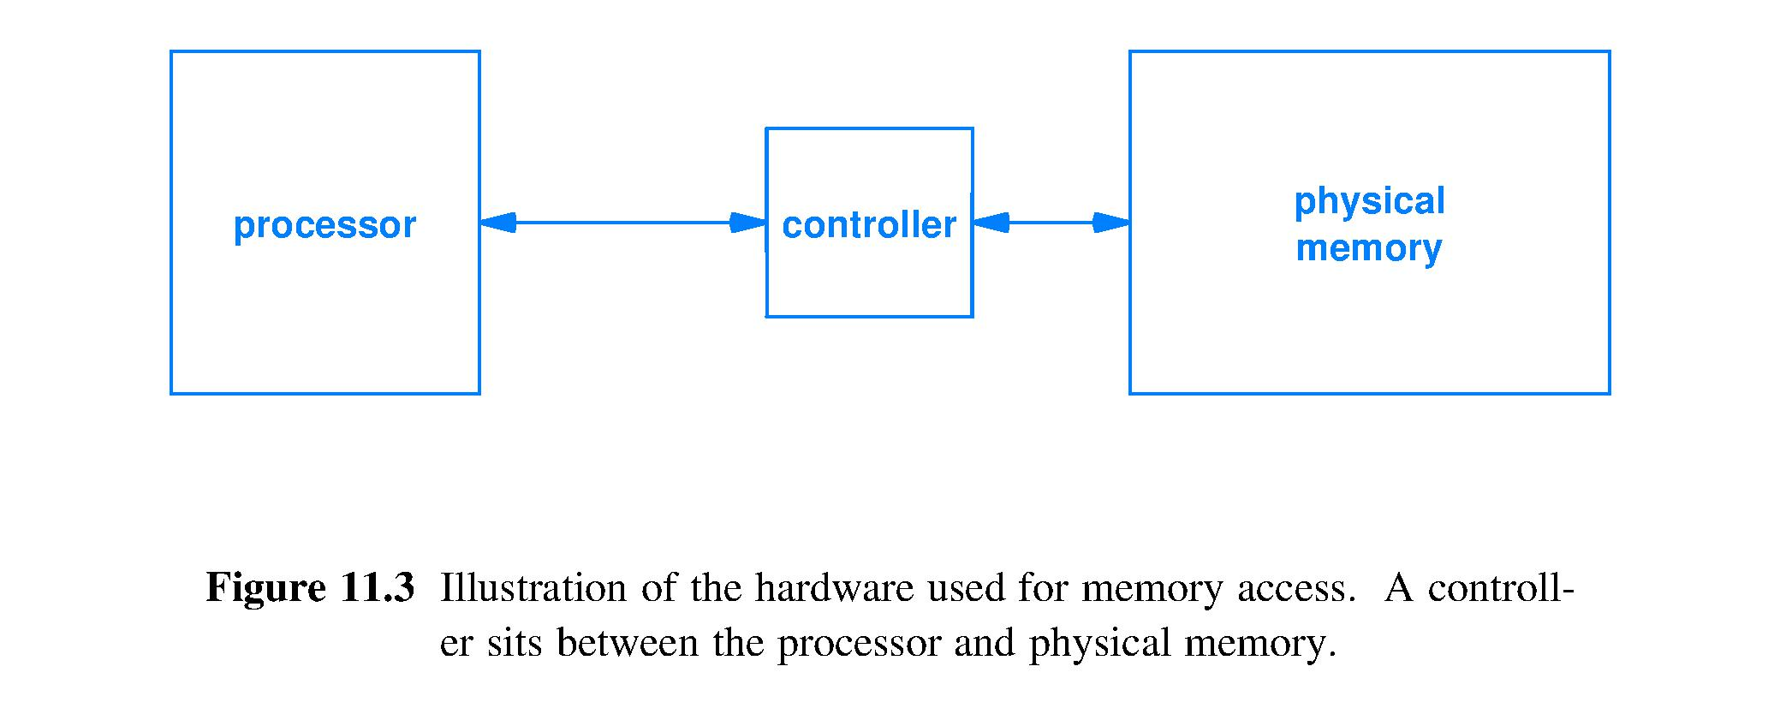
Memory organization
A memory controller connects a processor to a memory unit
Design of controller depends on the technology of the physical memory, e.g.,
SRAM controller is minimal: SRAM cell is two inverters, logic gates, same technology as processor
Flash controller is very complex: storage cell wear leveling, neighbor read charge drain compensation, etc.

Slide 6
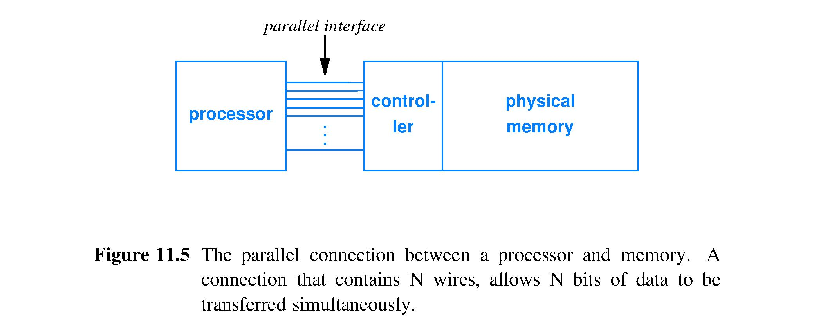
Parallelism in interface to memory
Parallel interface used between processor and memory
Interface is called a bus

Slide 7
Steps in a memory request
Processor
Presents request (read or write) to controller
Waits for response
Controller
Translates request into signals for physical memory
Responds to processor as quickly as possible
Prepares memory for next request
Writes to memory are often buffered
Processor places address and data in a queue
Processor can request writes frequently, without stalling on slow memory writes, unless queue is full

Slide 8
Memory transfer size (word size)
Number of bits, N, transferred to processor from memory simultaneously; determined by bus implementation (designer choice)
N is the word size, or word width, and is typically: 16, 32, and 64 bits
Larger words increase performance
Important to programmers
Word size is a quick way to characterize the performance of a computer; larger corresponds with faster, because more hardware parallelism

Slide 9
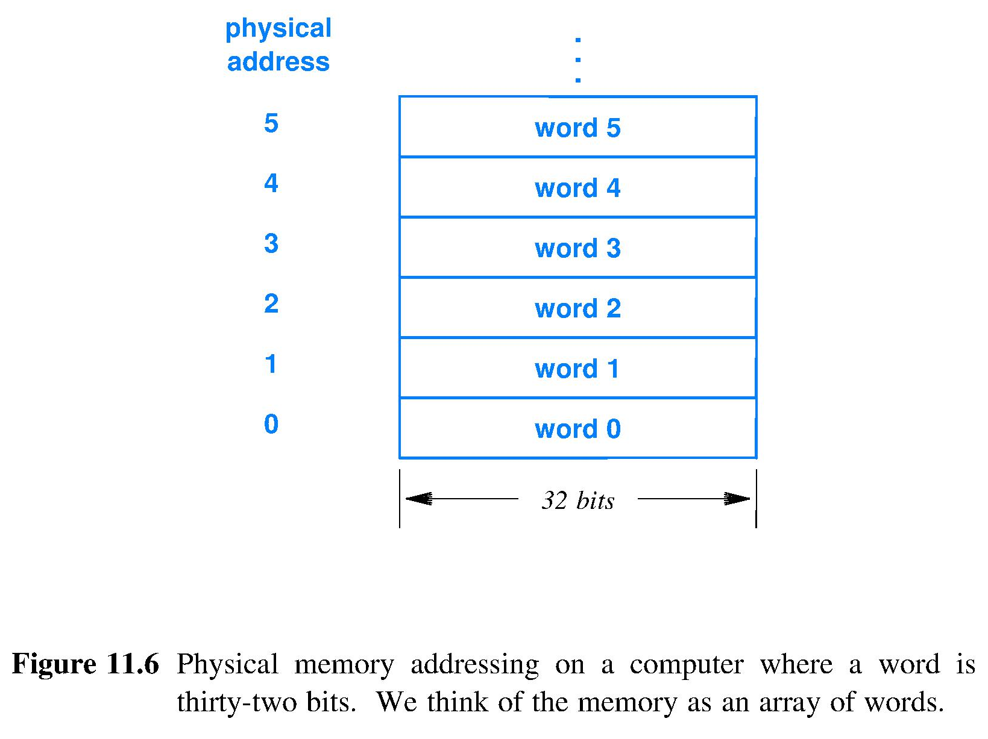
Physical memory address & organization
Each physical memory address corresponds to a word
Physical memory is organized as an array of words (more parallel than an array of bytes)
Hardware reads or writes an entire word at a time, to improve performance

Slide 10
Byte addressing and translation
Byte addressing
View of memory presented to the processor
Each byte of memory is assigned an address
Convenient, traditional for programmers
However, underlying hardware uses word addresses (more parallel, higher performance)
Memory controller
Translates byte addresses to word addresses

Slide 15
Aligned objects in memory
Designing for flexibility or performance when fetching multibyte and 2^{k}-byte objects
Flexible: first byte of object can be at any byte address
Performance: first object byte should be aligned with the first byte of a physical word of memory
If object size is not a multiple of memory word size then may pad the object to make object size be a multiple of the word size

Slide 16
Measures of memory size
Some types of memory are naturally constructed in power-of-two capacities
2¹⁰ kB, 2²⁰ MB, 2³⁰ GB, 2⁴⁰ TB, 2⁵⁰ EB, 2⁶⁰ PB bytes are
One Kilo-, Mega-, Giga-, Tera-, Exa-, Peta-byte (old)
2¹⁰ kB, 2²⁰ MB, 2³⁰ GB, 2⁴⁰ TB, 2⁵⁰ EB, 2⁶⁰ PB bytes are
One Kibi-, Mebi-, Gibi-, Tebi, Exbi-, Pebi-byte (SI, new)
Some memory types are not: e.g., hard disks
Capacity is measured using powers of ten
1000⁰ = 1 kiloByte, 1000² = 1 MegaByte, 1000³ = 1 GigaByte, 1000⁴ = 1 TeraByte, 1000⁵ = 1 ExaByte, 1000⁶ = 1 PetaByte byte
Notes:
A 64-bit byte-addressed address space holds 16 exbibytes of information.
A gram of DNA can theoretically hold 455 exabytes.^{[10]}

Slide 17
Increasing physical memory performance
Make memory hardware more parallel, so perform more accesses simultaneously
Memory banks – harder for programmer to realize the performance potential
Memory interleaving – easy to exploit in code if you understand the favored patterns of access

Slide 20
Stride and interleaved memory
Stride is the memory address increment from access to the next
Stride determines when a given interleaved memory module will be next accessed
Desire: do not access a module again until all stall clock cycles for that module have expired
Basic design is to make “Stride of 1” have no stalls
Achieved when there are at least as many memory modules as there are clock cycles of latency between two consecutive accesses to the same module
Big design question: What other stride values and module numbers combinations have no stalls?

Slide 21
Interleaving and cyclic group generators
Best constant strides are those with a pattern of memory access that returns to a module only after a delay ≥ module latency
Such strides fully hide the stall cycles of each module with useful accesses to other modules
Module names, (0, 1, 2, …, 2^{logN}-1), and addition modulo 2^{logN} form an algebraic structure called a cyclic group
A generator is a group element that when used repeatedly with the operation will generate all group elements; order of production is immaterial
“Stride = 1” is a generator; any others?

Slide 22
Explore potential group generators
Code that tries all stride values for (i = 0; i <= 1023; i = i + j) { array[i] = array[i] + 7; }
j=1 gives i=i+1 and stride=1; j=2, stride=2; …
Assume 3 clocks of stall after memory chip access and 4 interleaved modules
j=2 generates which cyclic group elements?
i=0 so first access is array[0] in module 0, then i=i+2,
Next access is to array[2] in module 2, then i=i+2,
Next access is to array[4] in module 0; access pattern set
j=2 NOT a generator; modules 1 & 3 not accessed
J=2 does not hide all stalls for this memory design

Slide 23
Content addressable memory (CAM)
Content addressable memory is also called associative memory
Has “slots” of N bits where N is usually tailored to exactly the need rather than always a power of 2 bits or bytes
CAM does not use pointers for access, instead
Presented with a key for matching with content
Hardware simultaneously tests for key match at every bit in CAM, performing a search in fixed, constant time, O(1)
Result is index of slot(s) where value found

Slide 24
CAM characteristics
Expensive hardware; each storage bit requires
Drivers to fan out key bits to all comparators in all slots, e.g., key_bit_i XNOR slot_bit_i for all bits 0 ≤ i ≤ N-1
For each slot, tree of k-input AND gates to AND the N XNOR bitwise comparison results into a Slot_Match signal
Circuitry to sequence the readout of all matches
Expensive operation
on every search, all of the circuitry switches at once: huge power surge
big wires needed to distribute V_{dd} and ground
big heat pulse within the chip

Slide 25
All bit positions throughout the array are compared to their corresponding key bit simultaneously. Massively parallel design yields single clock cycle identification of matches.

Slide 26
CAM search can return associated information in 1 cycle; used to match IP number with its forwarding information in internet routers.
Field(s) associated with each CAM entry
Route
…

Slide 27
Ternary CAM (TCAM)
Variation of CAM that adds partial match searching
Each bit in slot can have one of three values
Zero
One
Don’t care
TCAM ignores “don’t care” bits and reports match
TCAM can either report
First match
All matches (indicated using a bit vector)

Slide 28
Summary
Physical memory
Organized into fixed-size words
Accessed through a controller
Controller can use
Byte addressing when communicating with a processor
Word addressing when communicating with a physical memory
To avoid arithmetic, use powers of two for
Address space size
Bytes per word

